Slide 1



Quantizing the Unseen: Undergraduate Optical Research
Parker Landon
Mentor: Dr. Pavlina

Slide 2
A Big Thank You To:
Embry-Riddle’s Undergraduate Research Institute
And Arizona Space Grant Committees

Slide 3
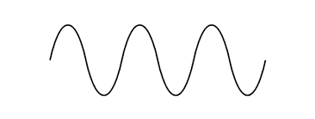
Previous Work - AM Servo System

Slide 4
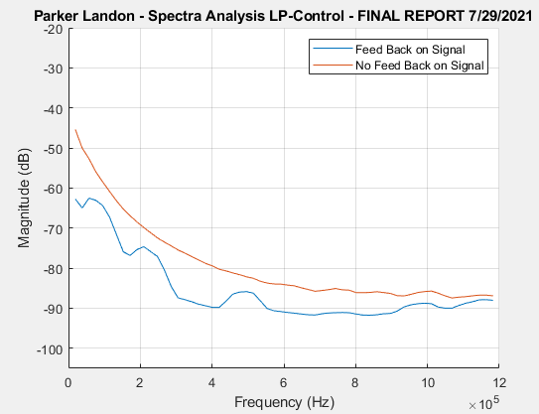
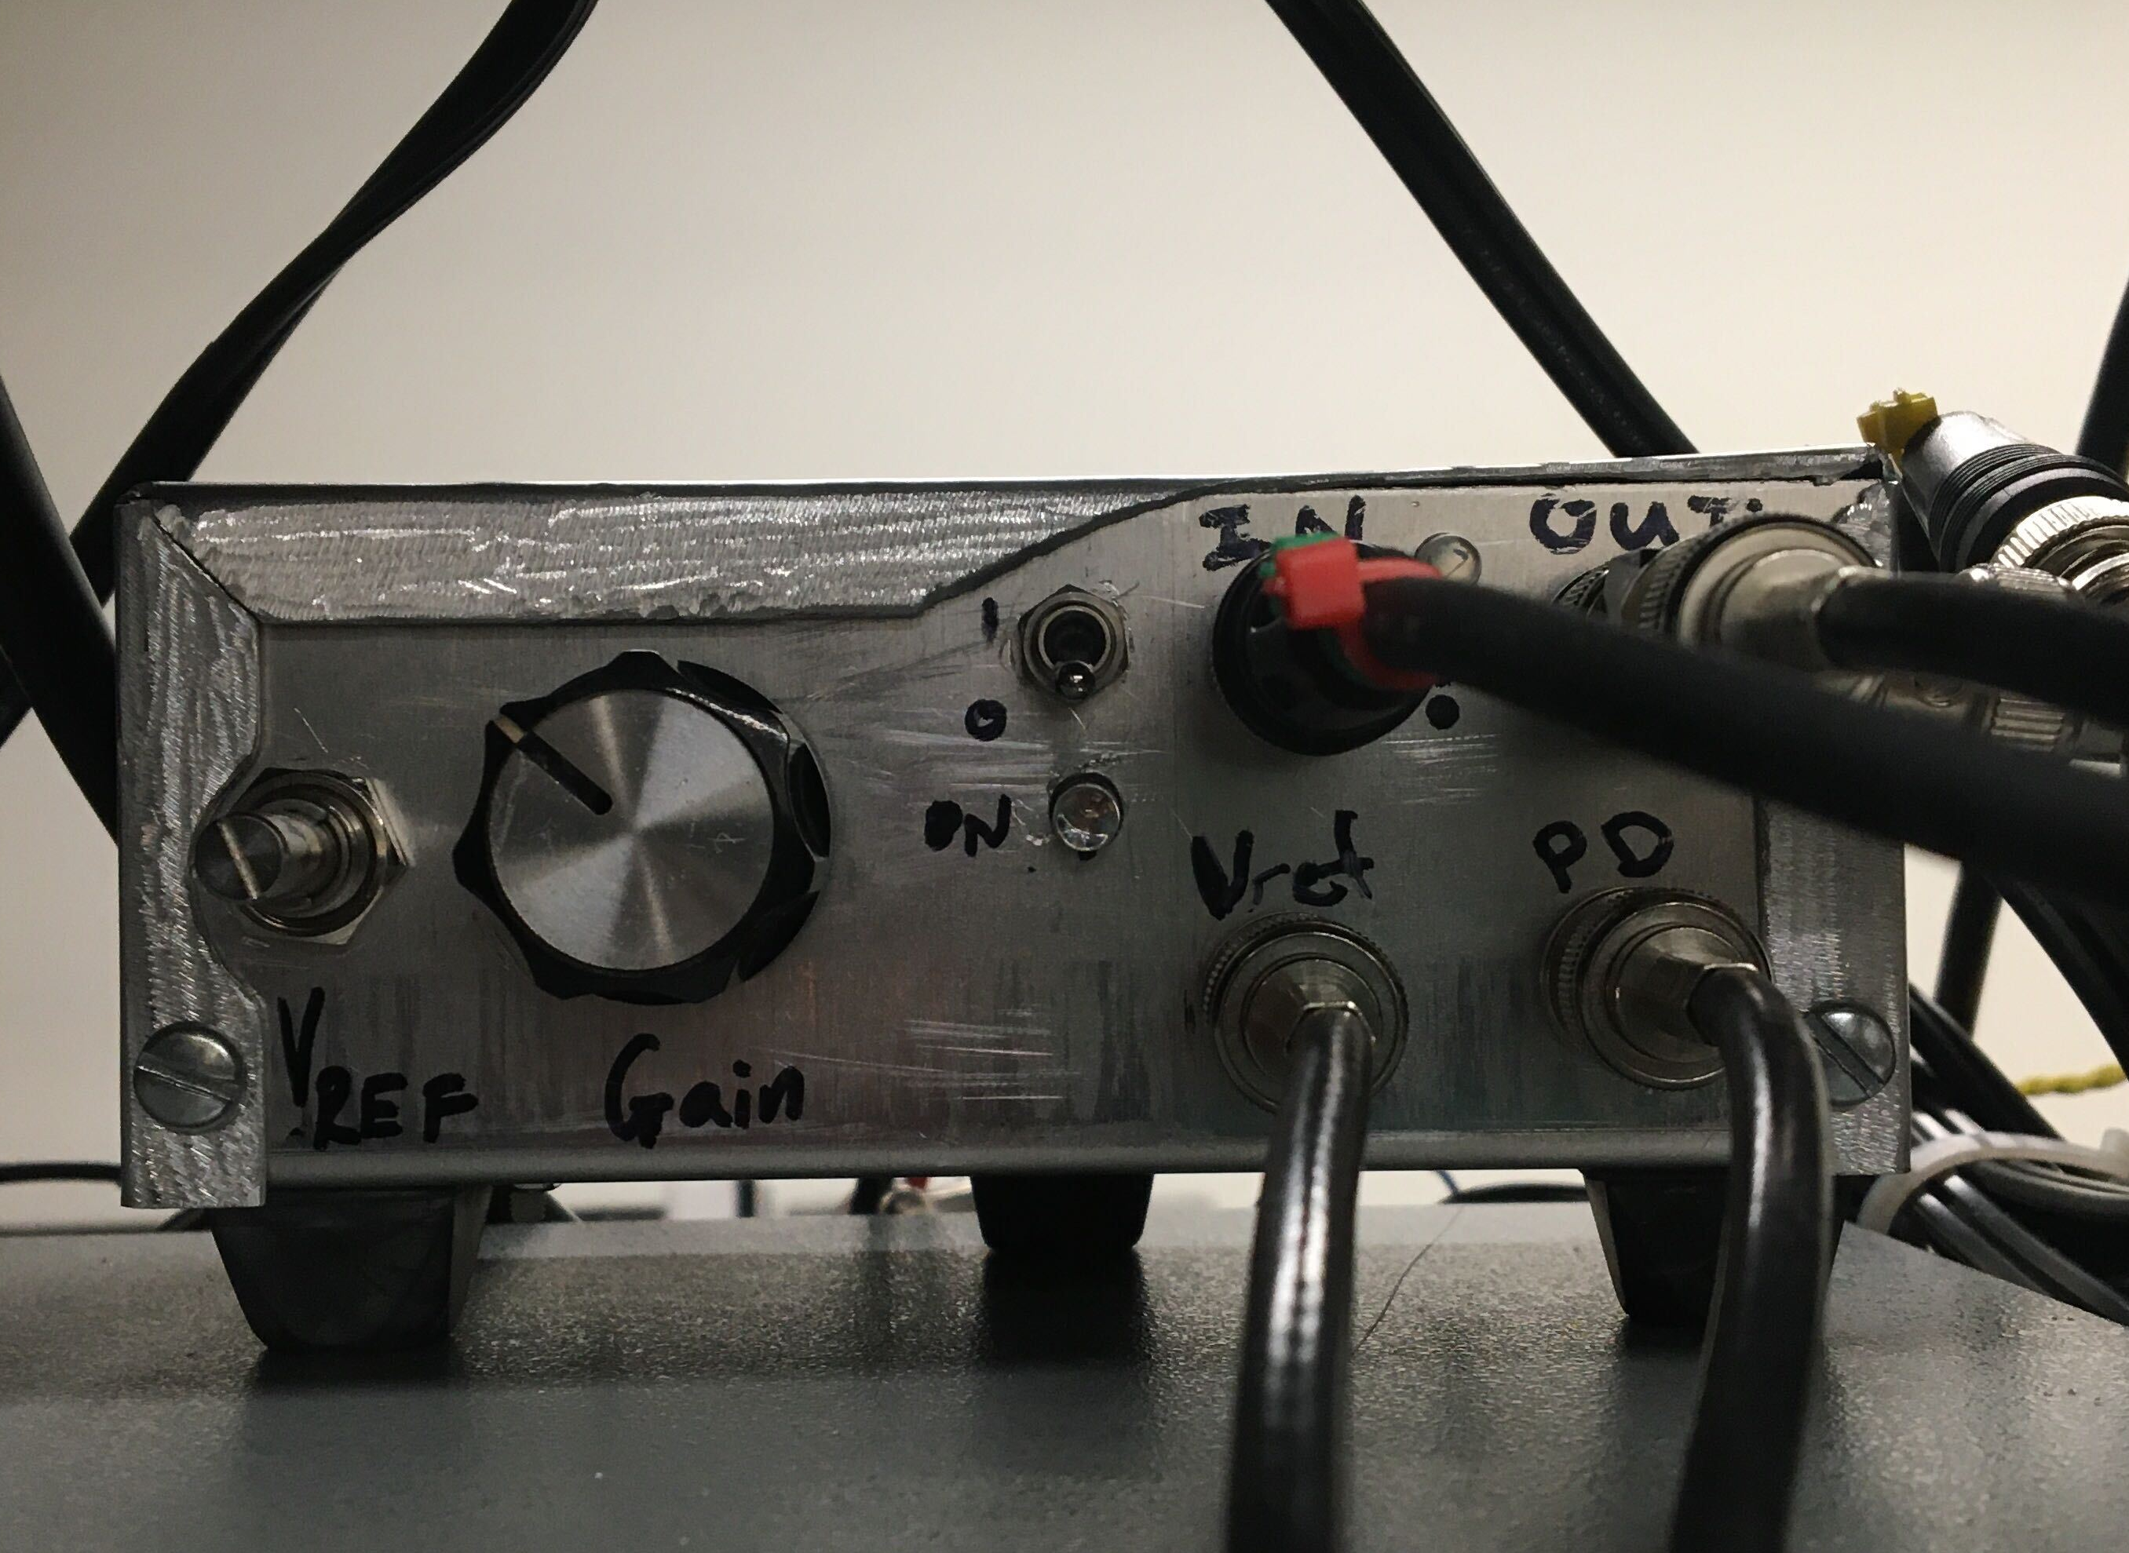
Amplitude Servo Closed Loop Response

Slide 5
Background
Vibrations
Laser System
Light
Power
“Noise”
Thermal

Slide 6
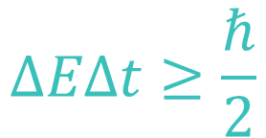

Background
Laser System
Light
Power
$$hνB$$
“Quantum Noise”
$$ΔEΔt≥\frac{ℏ}{2}$$
Heisenberg Uncertainty:

Slide 7
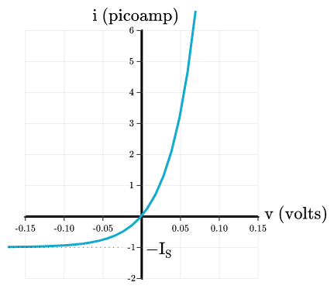
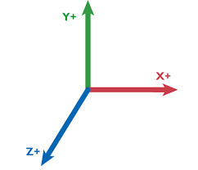
Diode Laser Modeling

Slide 8
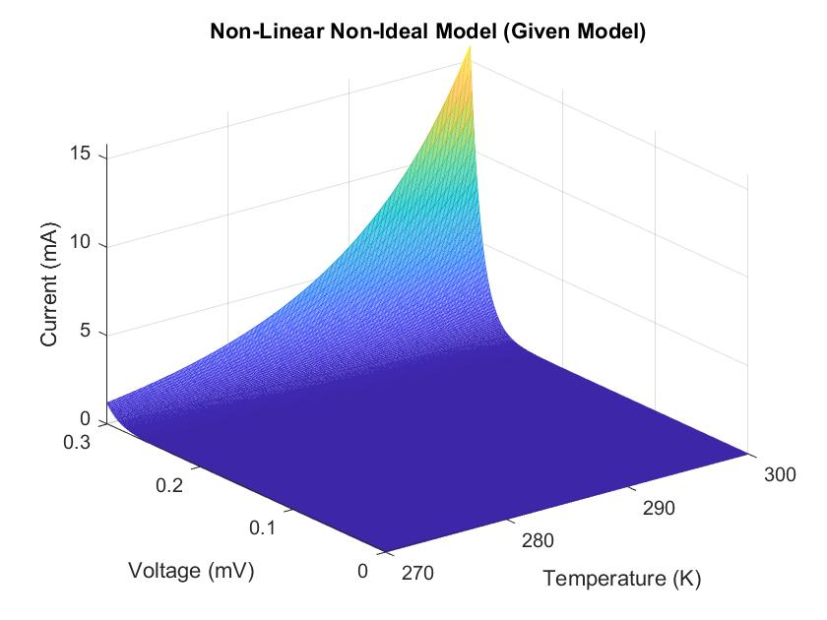
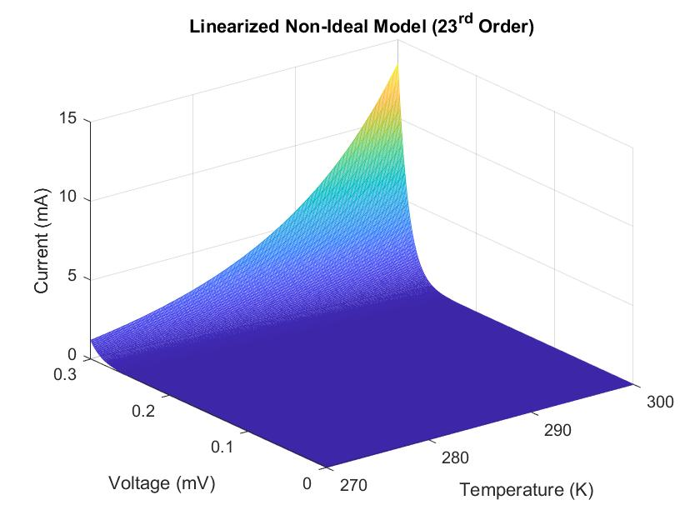
Diode Laser Modeling
(My Model)

Slide 9
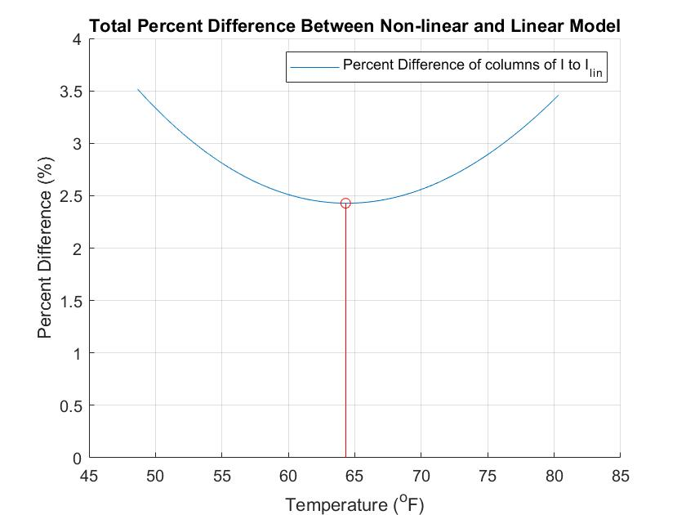
Diode Laser Modeling

Slide 10
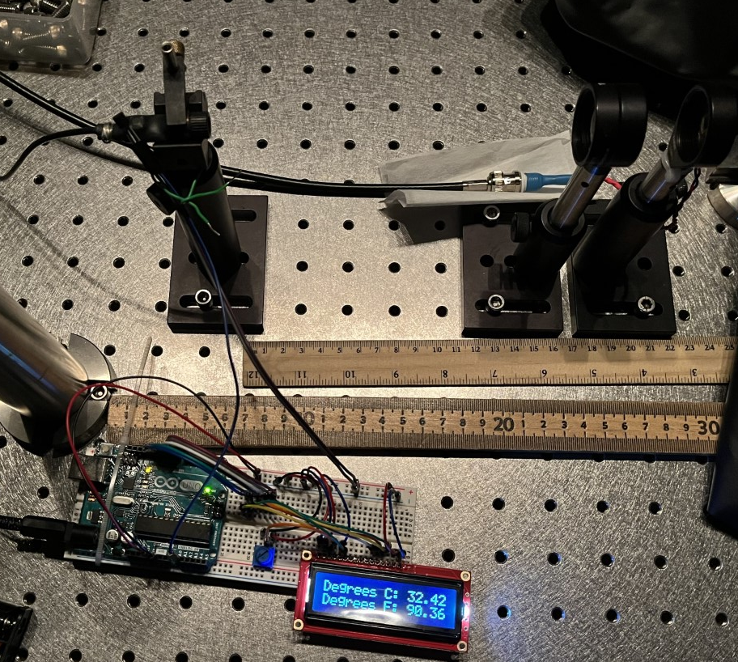
Experimental Testing

Slide 11
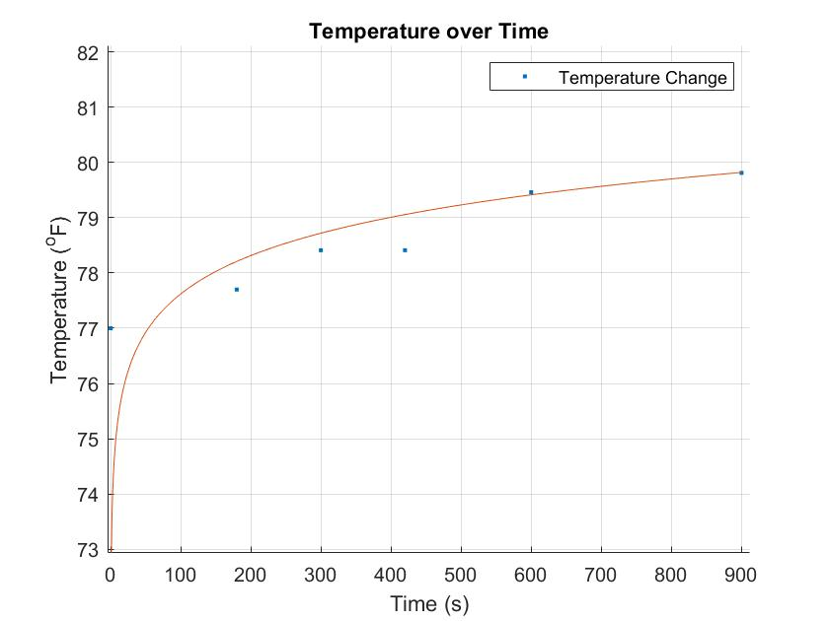
Experimental Testing

Slide 12
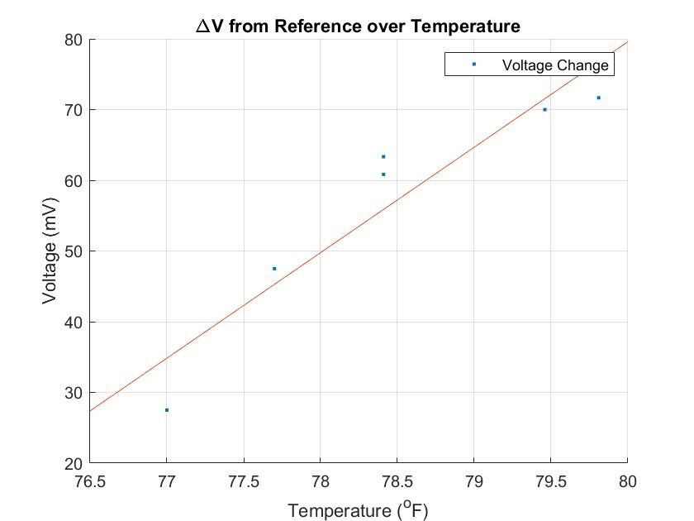
Experimental Testing

Slide 13
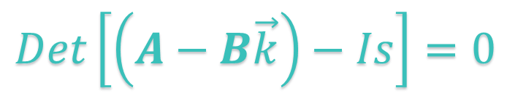

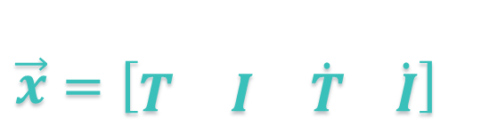
Current Goals
$\vec{x}=\left[\begin{matrix}T & I & \dot{T} \dot{I}\end{matrix}\right]$
We were able to experimentally prove our model!
Now we can duplicate this for different temperature ranges for optimization
$$\dot{x}=Ax+Bu \\ y=Cx+Du$$
$Det\left[\left(A−B\vec{k}\right)−Is\right]=0$

Slide 14
Conclusions
Modeled the optoelectrical response of a diode laser
Linearized the model using Taylor Expansions
Verified the models via experimental data
Next up…
Develop a state space controller for different temperature regions
Test the controller responses in Simulink

